Slide 1
The Intensive English Enrichment Program (IEEP)
SETTING STUDENTS UP TO SUCCEED

Slide 2
Introduction: A.J. Kennedy
Born and raised in New Jersey, USA.
Princeton University; Class of 2010
Psychology major; Certificate in Teacher Preparation
Certified Teacher; Princeton-In-Asia Fellow
Two years experience as director of summer sports camp for children ages 6-12.
Two years experience working in the After School Program at the Eden Institute for Individuals with Autism.

Slide 3
2 OBJECTIVES
OF THE IEEP
1. For students to develop fluency in and mastery of the English language
2. To foster a learning environment that develops creativity, critical thinking, problem solving, and 21st century skills.

Slide 4
Four Guiding Principles
Giving the Program Direction

Slide 5

CREATIVITY
The process of having original thoughts that have value

Slide 6

CRITICAL THINKING
The process of using creative thoughts and other data to see the bigger picture

Slide 7

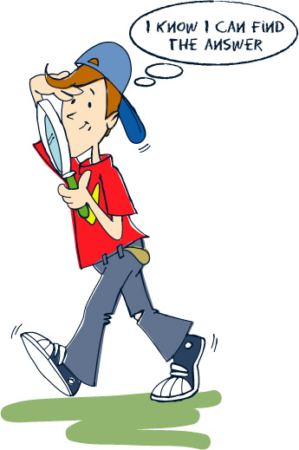
PROBLEM SOLVING
The process of using the bigger picture to make the world a better place

Slide 8

21st Century Skills
The skills students need in order to be successful in today’s world

Slide 9

21st Century Skills
Global Awareness
Innovation
Collaboration
Flexibility
Information Literacy
Media Literacy

Slide 10
Benefits of the
Four Guiding Principles
Helps students develop the skills they need to be successful at the university level and beyond in their adult life.
Provides teachers with expectations and structure when planning lessons and assignments.
Students understand what they are trying to accomplish within the program.

Slide 11
READING AND WRITING
THE FOUNDATION OF THE PROGRAM

Slide 12
CRITICAL COMPONENTS OF READING AND WRITING COURSE
Reading Real Literature
Creative Writing
Journals
Grammar
Independent Reading

Slide 13
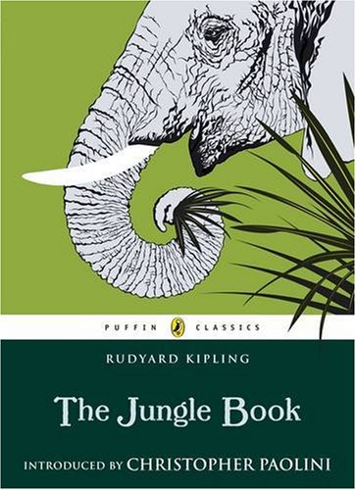
READING REAL LITERATURE
Students are turned off by predictable textbooks and by materials that are not engaging.
Worksheets taken from textbooks often do not stimulate creativity, critical thinking, or problem solving.
Real literature, and activities that can be derived from it can be designed to do just that.

Slide 14
BENEFITES OF READING REAL LITERATURE
Enhanced critical thinking through topics such as character development and changes in plot and theme.
Increased student engagement as the story develops over time rather than a new one-page story each week.
Significantly easier to foster a connection across the curriculum with other content areas.

Slide 15
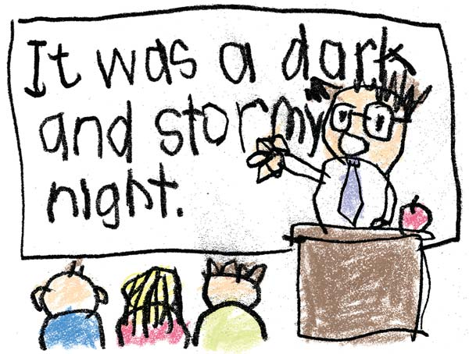
CREATIVE WRITING
Creativity is the foundation of all higher order thinking.
Writing stories is fun and one of the most engaging things we can do.
It’s a win-win for everyone.

Slide 16

JOURNALS
Keeping a journal helps students in many ways
It is a great way to strengthen writing skills through routine writing
Gives students freedom to write about anything they choose
Allows teacher to identify common mistakes and problem areas

Slide 17
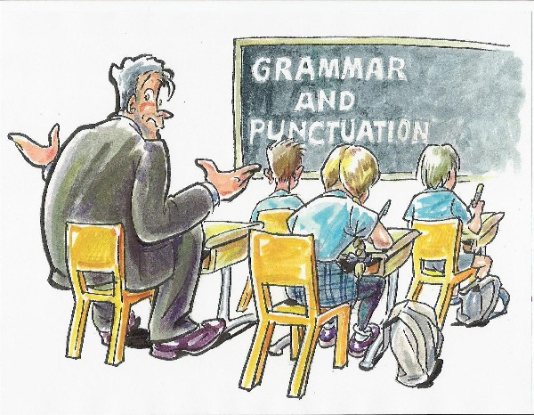
GRAMMAR
Grammar is not very fun for the teacher or the student but it is a vital part when mastering any new language.
Acknowledging this fact benefits everyone involved.
A solid grammar textbook will become a critical part of the Reading and Writing course.

Slide 18
INDEPENDNENT READING
English abilities within a class vary to greatly for book selection to be appropriate for every student.
One way to combat this is to have students reading English literature outside of the classroom.
Students will complete reflections and reports periodically on the books they read outside of class.
Grants students freedom to read literature they are interested in and find engaging.

Slide 19
CONNECTING THE CURRICULUM
TIEING IT ALL TOGETHER

Slide 20
THE FOUR GUIDING PRINCIPLES ACROSS THE SUBJECT AREAS
Science and Math is all about problem solving
Social Studies is all about critical thinking
Performing Arts is all about creativity

Slide 21
Subject Areas as compliments to the Reading and Writing Foundation
Let’s say a class is currently reading The Jungle Book, in the Reading and Writing Course.
For Performing Arts, a final project may be writing an original play about life in the jungle.
For Social Studies, students may create a presentation on how the deforestation of the rainforests could impact future generations.
For Science, a final project may ask students to come up with a way to protect the habitat of an endangered species.

